Slide 1


“Thousands of partners sign in to our platform every hour. The response time from the Face API is incredible, enabling us to verify our drivers without slowing them down.”
Dima Kovalev, Product Manager, Uber
Face API
Read Case Study Here
See Video Here
Notes:
Summary
Millions of people worldwide have embraced Uber as a new means of reliable transportation and flexible income. To safeguard against fraud and enhance both driver and rider peace of mind, Uber uses the Face API, part of Microsoft Cognitive Services, to help ensure the driver using the app matches the account on file. The extra verification step is fast, works on all smartphones and in dim light, and scales to more than 1 million driver-partners. By using the Face API, Uber saved months of development work, time it could devote to tailoring the user experience.
Challenge
Uber sends photos of drivers to riders as soon as their ride is on the way, but occasionally the Uber driver who shows up doesn’t look like the person in the photo that the rider receives. Uber wanted to make sure that the person it had screened and approved was the person behind the wheel.
Solution
Uber decided to use photo-matching to verify drivers when they signed in to the Uber app. Drivers would periodically take and submit a selfie to verify their identity. Uber used the Microsoft Cognitive Services Face API to build its Real-Time ID Check feature. The Face API supported the ability to compare photos in varying pose, focus, and lighting conditions.
Benefits
Three-week development time and rapid time-to-market with new driver authentication step
Amazing performance, which provides quick authentication without slowing down drivers
Very high photo-matching accuracy
Scalable to support up to 1 million users
https://customers.microsoft.com/en-US/story/uber

Slide 2
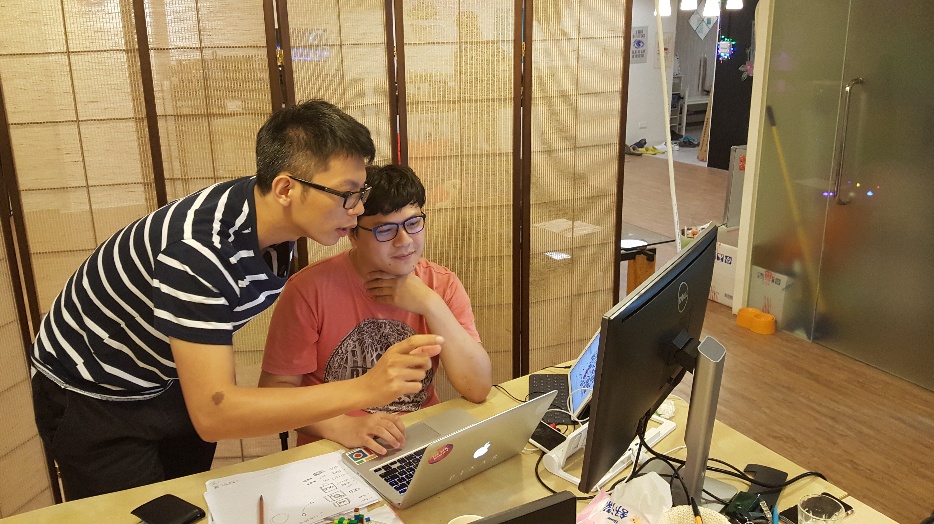

“Users are saying that search results in our app are now more relevant and safer than when we were using the Google Image Search API…. It has been a huge plus having the Bing Image Search API in PicCollage.”
Cardinal Blue Software Head of Business and Partnerships Ching-Mei Chen
Bing Image Search API, Computer Vision API, Face API, and Emotion API
Read Case Study Here
Notes:
Summary
Cardinal Blue Software, with offices in both San Francisco and Taipei, makes PicCollage, a popular mobile app that allows users to combine photos, videos, captions, stickers, and special effects to create unique collages and images that they can share with friends. PicCollage is a top ranked app with more than 120 million downloads. Using a set of APIs from Microsoft Cognitive Services, Cardinal Blue is now expanding the capabilities of its apps and offering customers new ways to express their creativity.
Challenge
When Apple launched the iPhone and iPad, Cardinal Blue Software cofounders John Fan and Ching-Mei Chen recognized a new opportunity to develop mobile apps. They quickly narrowed it down the focus of the app to be related to photos and the result was PicCollage, an app that allows customers to display multiple photos on one screen and position them in various ways to form collages. An important feature for PicCollage customers is the ability to search the Internet from within the app to find photos, videos, and other images—but Cardinal Blue encountered some serious problems with the first version of its web search feature which used the Google Image Search API.
Solution
After deciding to replace the Google API for web searching within PicCollage, the company researched a lot of alternatives. Cardinal Blue finally settled on the Bing Image Search API from Microsoft Cognitive Services. “Our key reasons for choosing the Bing Image Search API were its flexibility and power, plus its good ‘safe search’ capability,” Fan says. “Bing also allows related searches, which we’ll be adding to our app soon.”
Benefits
Provide safer and more relevant search results for users
Create new apps and add new features quickly, sometimes in just hours
Implement complex capabilities easily, and focus on creative work and product functionality, rather than coding and writing algorithms

Slide 3

“We found Cognitive Services to be the missing piece in the equation, the one that we needed to bring this solution to market and really revolutionize the way people look at video.”
Katie McCann, Vice President of Product and Engineering, Prism Skylabs
Computer Vision API
Read case study here
See video here
Notes:
Summary
Prism Skylabs was founded with a mission to bring business intelligence to ordinary cameras all around us. The company created the Prism Vision app, using Microsoft Cognitive Services APIs, to help organizations of all sorts and sizes easily search through their camera networks for particular events, items, and people. With Computer Vision from Microsoft Cognitive Services, Prism is expanding its reach to new industries and revolutionizing the way that businesses use video.
Challenge
In order to help companies unlock the value in the video from their IP camera networks, Prism needed a way to tap into deep computer learning expertise to automatically analyze and categorize the content of video, eliminating the need for humans to manually view and log footage.
Solution
Prism created its Vision app using the Computer Vision API from Microsoft Cognitive Services and developed strategic partnerships with companies covering roughly 80 percent of the IP camera market.
Benefits
No need for manual video logging
Easy access to sophisticated computer learning functionality
API is pretrained with an extensive library of people and objects
API calls were easy for developers to incorporate into the software
Additional APIs offer the potential to enhance and expand the solution
https://customers.microsoft.com/en-us/story/prism-skylabs-cognitive-services

Slide 4
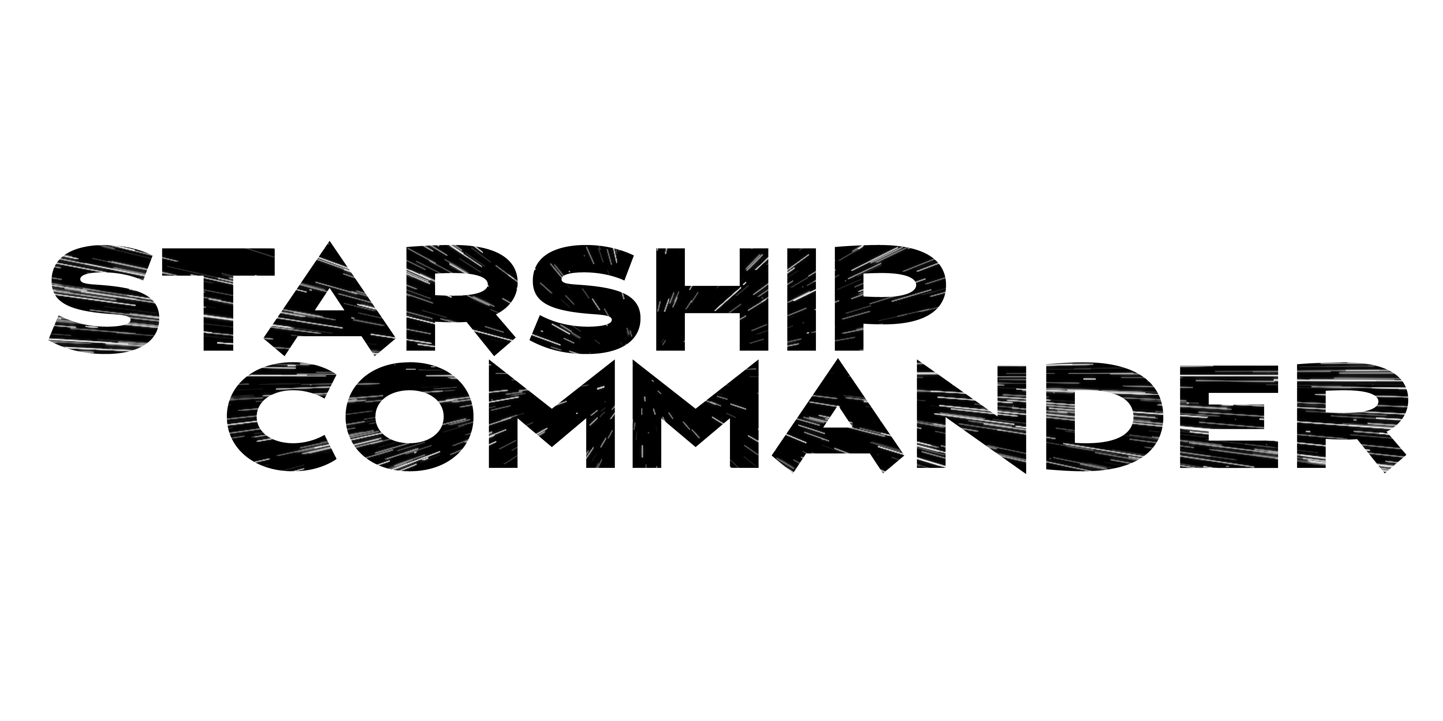
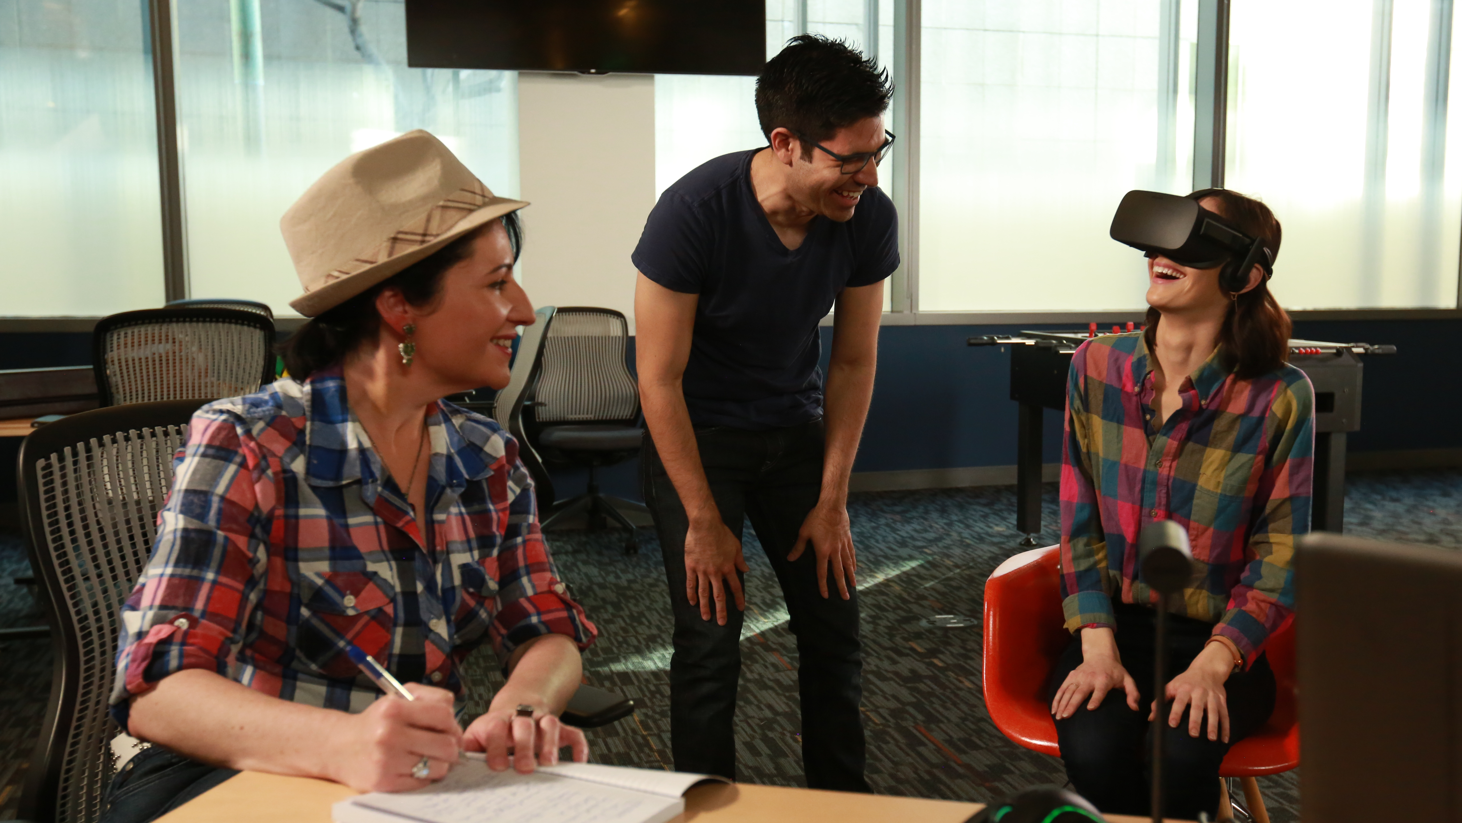
“The only reason we can build a product like this is because we are building on the deep learning and speech recognition expertise at Microsoft to deliver an entertainment experience that will be revolutionary.”
Alexander Mejia, Owner and Creative Director, Human Interact
Custom Speech Service, LUIS
Read case study here
See video here
Notes:
Summary
Setting out to create the most compelling, lifelike experience possible, Human Interact built its virtual reality (VR) game, Starship Commander, around human speech. To deliver high-quality, low-latency speech recognition, the company chose the Custom Speech Service (formerly CRIS) from Microsoft Cognitive Services. Adding the Custom Speech Service to the game was fast and easy, and the speech recognition is highly accurate, especially in the face of background noise and various speaking styles. The result is immersive, white-knuckle role-playing.
Challenge
In developing its first virtual reality (VR) game experience, Human Interact needed a speech recognition technology that provided extremely high quality, trainability, and low latency.
Solution
Human Interact chose the Custom Speech Service and Language Understanding Intelligent Service (LUIS) APIs from Microsoft Cognitive Services. Human Interact was able to train the Custom Speech Service with a custom script, which greatly contributed to speech recognition accuracy. LUIS adds natural language understanding so that characters in the game understand what players mean when they say something.
Benefits
Highly accurate speech recognition and language understanding, even with background noise and various speaking styles
Half the word error rate of competing technologies with no sacrifice in latency
Immersive play uninterrupted by technology glitches
Write once, deploy anywhere
Easy ability to update game vocabulary in the cloud
https://customers.microsoft.com/en-us/story/human-interact-cognitive-services

Slide 5


“Although we have image processing and machine learning experts on staff, we were able to get a highly accurate facial detection capability to market much faster by turning to Microsoft.”
Nadav Soferman, Cofounder and Chief Product Officer, Cloudinary
Face API
Read case study here
Notes:
Summary
Many applications and websites need to ensure that their photos of people display properly when reformatting for responsive design. To deliver accurate face-based images, Cloudinary used the Microsoft Cognitive Services Face API to add precise facial detection capabilities to its image management service in just two weeks. Hundreds of customers use the capabilities to crop millions of images a month automatically and accurately, and Cloudinary is exploring other Cognitive Services APIs to further improve its service.
Challenge
Customers began asking Cloudinary for more sophisticated image processing functionality around photos with faces: the ability to accurately detect the location of facial features, the age and gender of individuals in photos, and other features. Cloudinary wanted to get a highly accurate facial detection capability to market as quickly as possible.
Solution
Cloudinary turned to Microsoft and used the Microsoft Cognitive Services Face API to create a new feature called Advanced Facial Attributes Detection.
Benefits
Highly accurate facial recognition
Rapid integration into Cloudinary application
Great flexibility for developers to transform images on the fly
Great stability, even when processing millions of requests
Free Cloudinary staff to focus on other innovations
https://customers.microsoft.com/en-us/story/cloudinary-cognitive-services

Slide 6
“We were solving a specific problem to bring value to our customers, and we wanted a quick, elegant, and simple solution. We found it in Cognitive Services. ”
Aaron Edell, Chief Product Owner, GrayMeta
Computer Vision API
Read case study here
Notes:
Summary
GrayMeta helps companies make sense of ever-expanding accumulated storehouses of digital data. Its GrayMeta Platform product collects and organizes metadata from a company’s digital storehouse, and with Microsoft Cognitive Services APIs, it can also analyze video files and determine who and what is contained within them. This is an important benefit for the firm’s broadcast and media customers, who can now understand and easily locate the content that they own and make full use of their digital assets.
Challenge
Companies’ digital files are valuable assets, but many organizations struggle with the sheer number of files and the fact that they are all over the place. Broadcast and media firms may spend days or weeks searching through archives to find particular footage, or they may opt to reshoot footage that they already own but can’t locate. GrayMeta wanted to expand its metadata platform to also index the content of files to make it easy to find specific video content within the archives.
Solution
GrayMeta added the Cognitive Services Computer Vision API, Face API, and Emotion API to the GrayMeta Platform to quickly and easily analyze and tag the contents of video files based on content.
Benefits
Video content owners no longer need to manually view and tag footage
The Computer Vision API includes celebrity recognition – a key concern for media companies
GrayMeta platform now includes advanced computer learning with easy product integration
APIs eliminate the need to have a team of data scientists on hand
Using a Microsoft solution provides reliability, uptime, and resources to maintain a leading-edge solution
https://customers.microsoft.com/en-us/story/graymeta-media-cable-cognitive-services

Slide 7
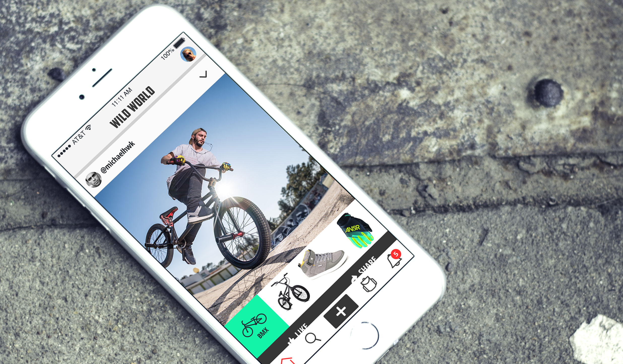

“The main problem we ran into with the Google Custom Search Engine was the lack of scalability and the constraints it placed on our user experience. With the Bing APIs … we’re able to deliver far more comprehensive, relevant results—the kind that keep customers coming back for more.”
WildWorld Chief Technology Officer Hassan Uriostegui
Bing Image Search API and Bing Autosuggest API
Read Case Study Here
Notes:
Summary
App developer WildWorld provides a unique online social-shopping community where people who are passionate about outdoor recreation (and gear) connect through shared experiences. People browse photos, identify and locate the products they see, and purchase them online at the best prices. The company switched from the Google Custom Search Engine to Bing APIs provided by Microsoft Cognitive Services to gain scalability, offer consumers far more comprehensive results, and accelerate its entrance into new vertical markets.
Challenge
WildWorld designed its app as an online social-shopping community where consumers devoted to outdoor recreation can post photos and stories about their adventures, browse the profiles of people who share their passions, and identify then purchase products that interest them. The company first used the Google Custom Search Engine to power its app but soon realized that the Google solution limited scalability, constrained the user experience, and failed to provide consumers with a full range of shopping choices.
Solution
WildWorld replaced the Google Custom Search Engine with two Bing application programming interfaces (APIs) from Microsoft Cognitive Services—the Bing Image Search API and the Bing Autosuggest API—to achieve “infinite scalability,” provide comprehensive image searching, and save people time when they enter search terms. “We think what Microsoft has created is extraordinary,” says WildWorld Chief Executive Officer Brett O’Brien. “By combining the Bing APIs with our technology and user experience, we power an innovative new way for consumers to interact with shoppable photos and the products associated with their experiences.”
Benefits
Build highly scalable applications
Add new features and capabilities quickly and easily, with just a few lines of code
Position the company to move easily into new markets

Slide 8

Bringing it all together
The Seeing AI Project
Computer Vision, Image, Speech Recognition, NLP, and ML from Microsoft Cognitive Services
Read Blog Here
Watch Video Here
Notes:
Here’s a preview of the Seeing AI project, which started as a research project that helps people who are visually impaired or blind to understand who and what is around them.
The app will use computer vision, image & speech recognition, natural language processing and machine learning from Microsoft Cognitive Services. The project is under development and is not available today but it shows what’s possible with the APIs.

Slide 9


“I have not seen anything comparable. We can use the Computer Vision API to prove to our clients the reliability of the data, so they can be confident making important business decisions based on that information.”
Vigiglobe CEO Leendert de Voogd
Computer Vision API
Read Case Study Here
Notes:
The Cognitive Services product marketing team will be building case studies on the APIs on a regular basis. Keep checking the Infopedia site for updates. Additionally, the Azure product marketing team will be building case studies on Cognitive Services as part of the Cortana Intelligence Suite marketing program. Depending on who your target audience is, you can use either or both team case studies on Cognitive Services.
Vigiglobe
Vigiglobe saw an opportunity to analyze not only what was being said on social media, but also the context in which it was being discussed. The team created proprietary algorithms to accurately interpret and contextualize social media messages in real time. Using the Computer Vision API of Microsoft

Slide 10


“Microsoft Cognitive Services gives us a huge range of opportunities. It’s a perfect match for us now, and in the future when we want to add more features to our app. The Computer Vision and Speech APIs are extremely powerful.”
Blucup CEO Jaan Apajalahti
Computer Vision API and Speech API
Read Case Study Here
Notes:
The Cognitive Services product marketing team will be building case studies on the APIs on a regular basis. Keep checking the Infopedia site for updates. Additionally, the Azure product marketing team will be building case studies on Cognitive Services as part of the Cortana Intelligence Suite marketing program. Depending on who your target audience is, you can use either or both team case studies on Cognitive Services.
Blucup
Finland-based Blucup was on a mission to solve a common problem: how can salespeople capture data while on the go? The company developed the Zero Keyboard app, which sales reps could use to record customer information quickly and add it automatically to their customer relationship management (CRM) systems using touch gestures, voice, and pictures. Using the Speech and Computer Vision APIs from Microsoft Cognitive Services, Blucup provides customers with accurate results and rich features—all while speeding development internally.

Slide 11
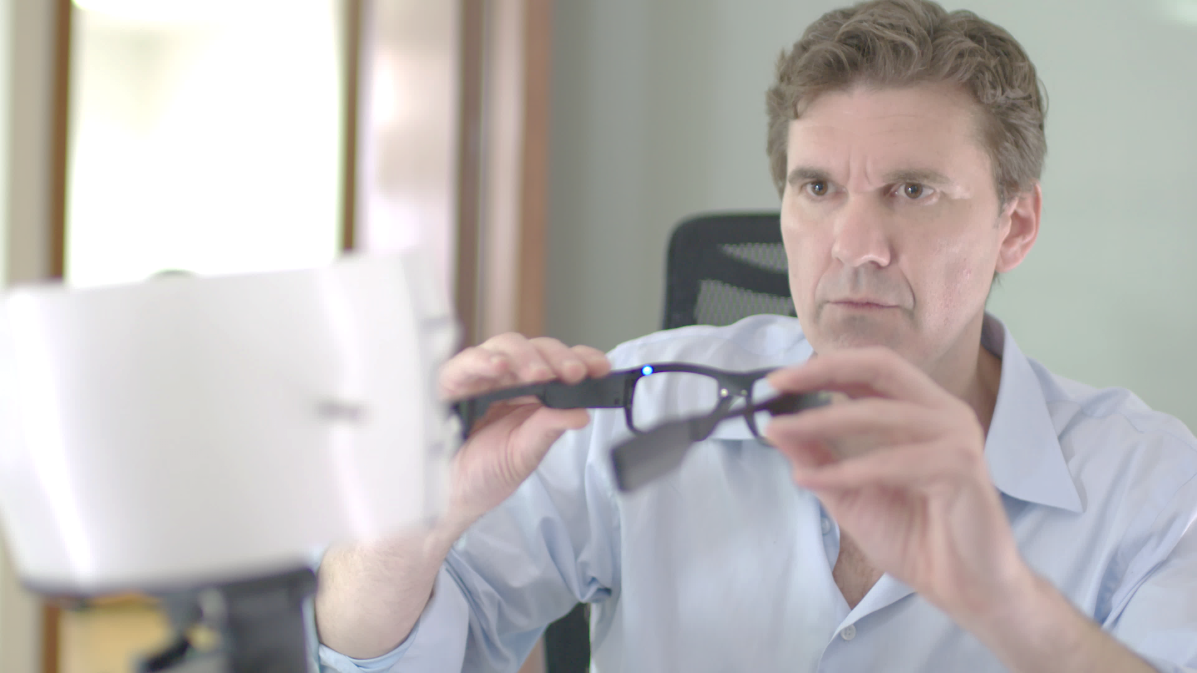

“One of our software engineers with no machine-learning or computer-vision experience was able to alter the device software to work with the Microsoft Cognitive Services APIs in a very short time.”
Pivothead R&D Director Benoit Chirouter
Computer Vision API, Emotion API, Face API, Speech API, and Language Understanding Intelligent Service
Read Case Study Here
Notes:
Summary
Pivothead makes wearable technology that looks like regular eyewear, but allows customers to shoot high-definition video, capture still images, and stream personal POV experiences live. Using Microsoft Cognitive Services APIs, Pivothead is working on a project for people with impaired vision, which incorporates software that translates images and text to speech, and provides detailed descriptions that help them “see” the world in front of them.
Challenge
Pivothead is a pioneer in wearable technology that combines eyeglasses with high-quality still and video cameras to allow people to create vivid point-of-view (POV) content and share what they see. Despite the company’s growing success, there was one challenge its researchers and engineers had never been able to overcome—creating a device that would provide a semblance of sight for people who are blind or visually impaired. For years, Pivothead had been working with university researchers on ideas for how to use the eyeglasses to support people with impaired vision but were never able to achieve a breakthrough until the company learned about the Microsoft Cognitive Services APIs.
Solution
Pivothead chose five of the Microsoft Cognitive Services APIs: Computer Vision, Emotion, Face, Speech, and Language Understanding Intelligent Service. Using those APIs in a prototype, Pivothead is building a smart device that looks like an ordinary pair of eyeglasses, but actually offers people who are visually impaired a window into the sighted world.
Benefits
Ease of adding complex functionality to product with no need for a data scientist or a computer-vision expert
Fast development time
New opportunities for the company and its products as the knowledge required to even attempt such projects was previously a barrier of entry

Slide 12


“Conversions related to recommendations account for 15 percent of our sales. The ability to automate recommendations and scale them to 10,000 products has had a big impact on our revenues.”
Miao Xue, Chief Information Officer, DutchCrafters
Recommendations API
Read Case Study Here
Notes:
Summary
The great thing about online shopping is the huge number of products to see. The bad thing about online shopping is the huge number of products to see. DutchCrafters, an online furniture store, incorporated the Microsoft Cognitive Services Recommendations API into its website to help customers winnow through thousands of choices and find their dream furniture faster. With just a few days’ work, DutchCrafters added the API to its code and boosted the company’s conversion rate through smart product recommendations.
Challenge
The blessing of selling online is also the curse: too many choices. DutchCrafters has more than 10,000 products on its website, each with customization options. Customers were abandoning the site in frustration, and the conversion rate was only 0.2 percent.
Solution
DutchCrafters guides online shoppers through its robust inventory by providing a recommendations capability that it built using the Microsoft Cognitive Services Recommendations API.
Benefits
Rapid development—about five days to integrate the Recommendations API into the company website
Instant addition of recommendations capability to all 10,000 products
Three-times increase in conversion rate
http://advocacypublic.clouddam.microsoft.com/en-US/story/dutch-crafters-retail-microsoft-cognitive-services

Slide 13

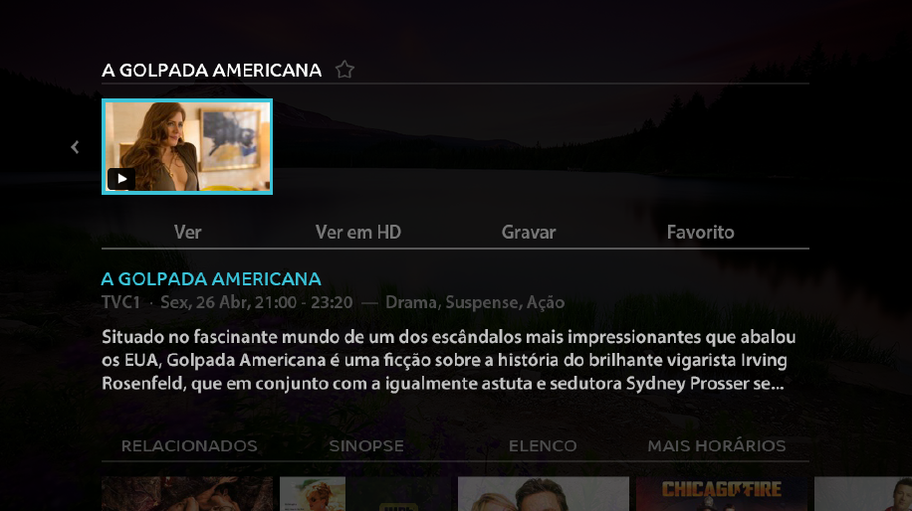
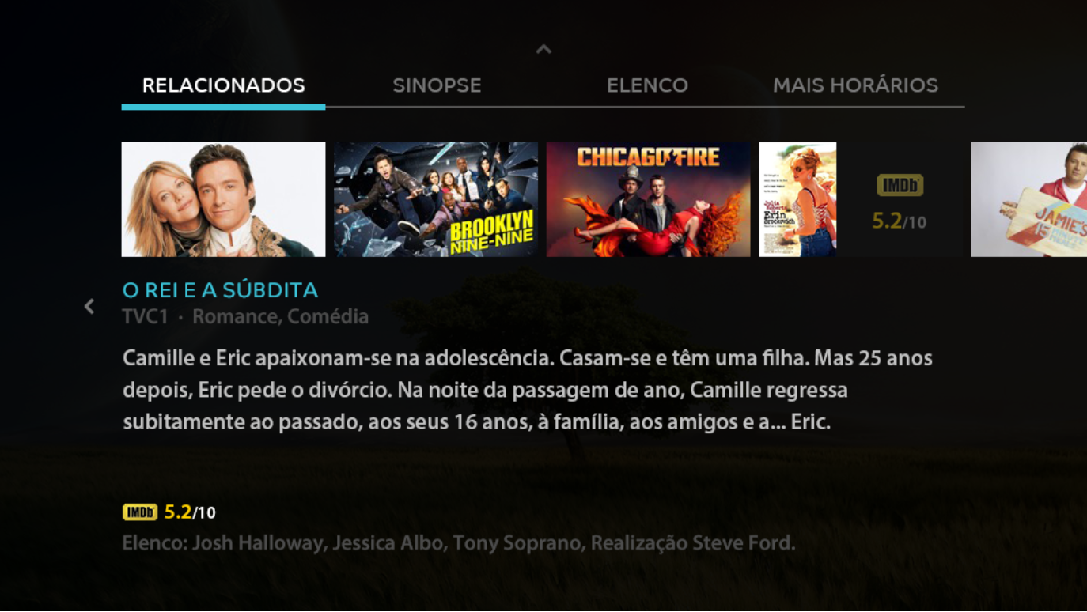
“The Azure Recommendations Service Engine is a central piece of MEO’s strategy to address the top two most pressing challenges: churn and additional revenue. It does so, by aiding the creation of a virtuous cycle of consumption that at once locks down our customers within our entertainment ecosystem, while increasing the contextualized and meaningful display of premium content to audiences that otherwise would not have contact with them.”
Joana Pina Pereira, Head of TV Business Department MEO at Portugal Telecom
Case Study
Notes:
3:00 – 5:00

Slide 14


“By leveraging Cortana Intelligence Recommendations capabilities combined with Azure Machine Learning processing power, we have enabled retailers with a Personalized Commerce Experience, allowing them to grow shopper engagement and conversions across all channels.”
Frank Kouretas, Chief Product Officer at Orckestra
Orckestra.com

Slide 15
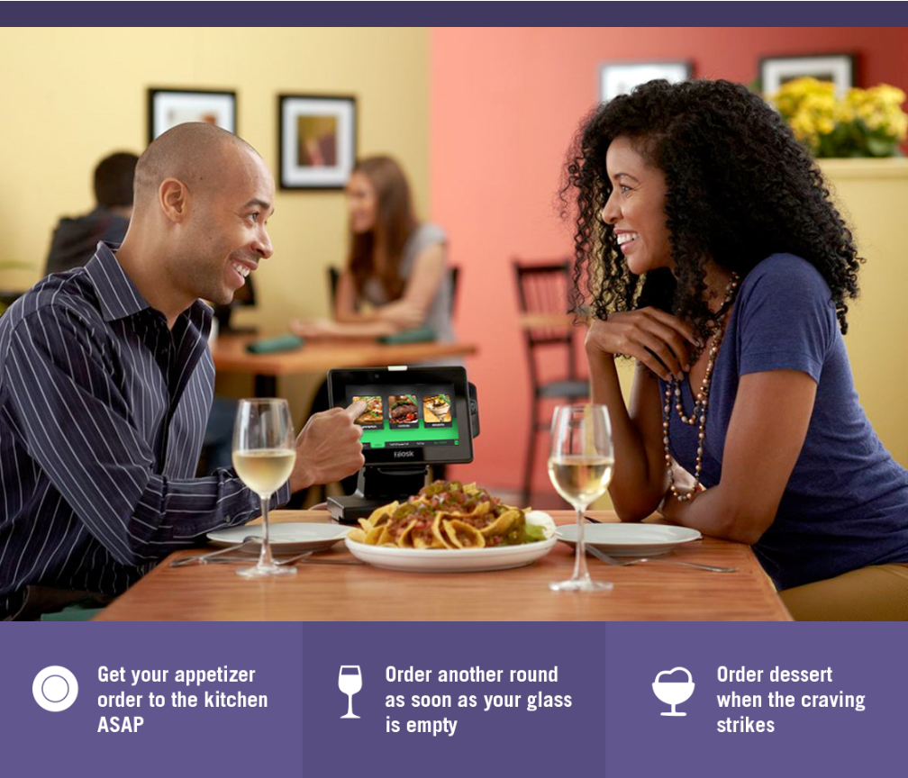

“Thanks to Text Analytics by Azure Machine Learning, we’re able to incorporate guest sentiment into our actionable guest feedback platform to deliver a comprehensive view of guest satisfaction and server performance.”
Al Pappa
Head of Business Intelligence Ziosk

Slide 16


The Recommendations API allows Allrecipes.com to harness billions of user-shared experiences to deliver highly personalized recipe solutions that answer busy families most pressing question, ‘What’s for dinner tonight?’
We are able to do this with minimal investment due to the proven capabilities of the Cortana Analytics platform. This helps us further realize our vision of providing highly personalized cooking inspiration for home cooks.
John Keane CTO, Allrecipes.com
Read Case Study Here
Notes:
Read the full case study here: http://advocacypublic.clouddam.microsoft.com/en-US/story/top-cooking-website-energizes-a-new-generation-of-cooks-with-personalized-recommendations

Slide 17
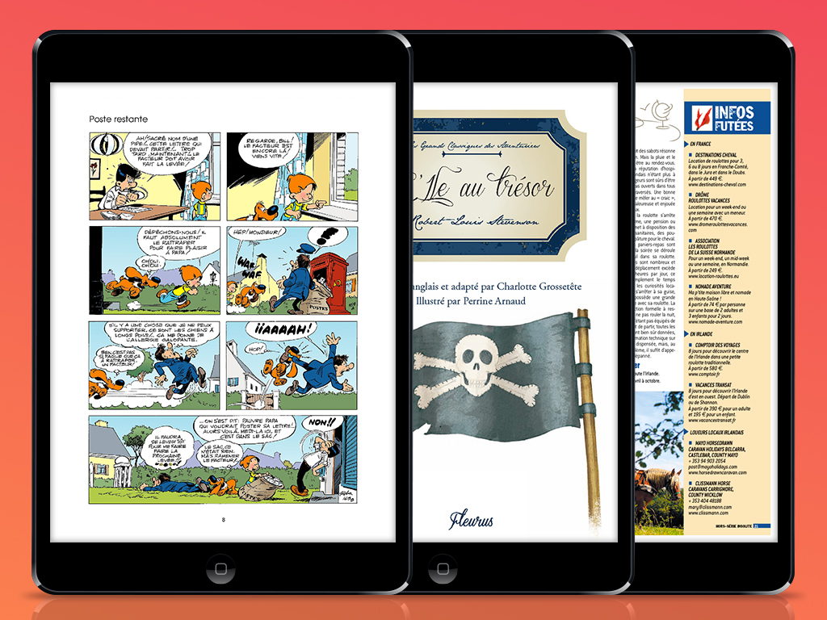

“Azure Machine Learning was really easy to use. The user interface is highly visual and there’s no coding to do. We uploaded reading histories and our catalog, and tuned the recommendation engine with experiments that varied the weights of our attributes. It was a two-week process to get an engine that produced highly appropriate results.”
Vincent Daubry Youboox CTO and Co-founder
Notes:
https://customers.microsoft.com/Pages/Download.aspx?id=19462
French e-book subscription service Youboox saw its recommendation engine as its long-term-growth engine. But a home-grown upgrade was expensive. Microsoft Azure Machine Learning offered a fast, simple, low-cost alternative that produced really great recommendations. The company now sees more user activity on its site, as well as more users coming to the site through recommendations.

